Slide 1
Academic Mentoring: Caring or Crisis Management
Dr Claire Gordon, Dr Akile Ahmet and Francesca Humi, Eden Centre
Pete Evanson, School Senior Advocate for Students
Steph Hackney, Mental Health Advisor

Slide 2
Aims and structure of the session:
Aims:
Facilitation of how academic mentoring is understood and experienced in its current form
Discuss how can academic mentoring be enhanced
Structure:
We will firstly present some preliminary findings from 2 surveys we have conducted
Secondly, we will facilitate a long table discussion
Thirdly we will talk through 7 scenarios and ways we would facilitate responses to each scenario

Slide 3
Some context
We have so far carried out 2 surveys in the Eden Centre on academic mentoring: 1 with Departmental Managers and 1 with undergraduate students
The results have shown the following:

Slide 4
What is happening across the school?
Geography – Academic staff only
Sociology – Academic staff only but with the view to change
Health Policy – Academic staff only
International Relations – Academic staff only
European Institute – Academic and PSS
Law – Academic and PSS
Social Policy – Academic and PSS (although not an officially developed model the UG prog manager has “developed the welfare side of the role”
Statistics – designated UG advisor for 1st years, members of academic staff for 2nd and 3rd years
Economic History – Academic staff and PSS to provide support and advice
PBS – Academic staff and PSS, PSS support with setting up of meetings and topics for discussion
Accounting – Guest teachers
Economics – Non academic staff – tutors, teaching fellows
Anthropology – Academic staff
Maths – Academic and PSS staff they currently have a mathematics study advisor (Maths Support Centre and Academic Mentor model in place)
Management - Academic and PSS
Government – Academic and PSS staff
Language Centre – Academic staff only

Slide 5
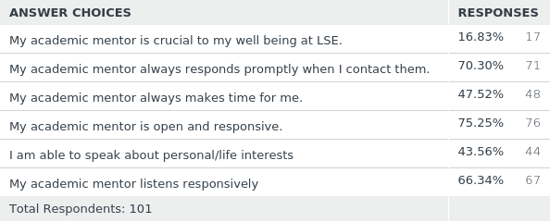
How would you describe your relationship with your academic mentor(s)? Please tick those that apply.
Answered: 101 Skipped: 18

Slide 6
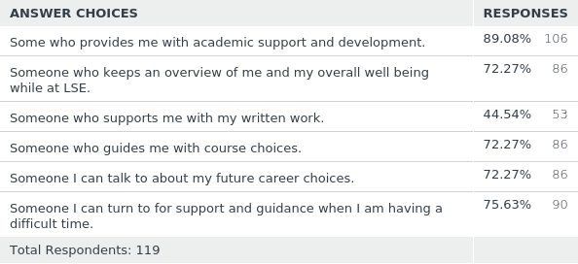
What do you think the role of the academic mentor should me?
Answered: 119 Skipped: 0

Slide 7
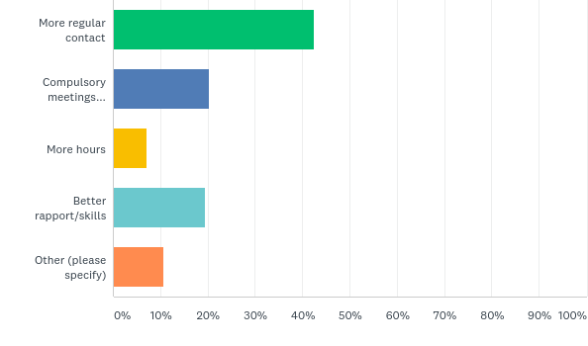
How could academic mentoring be improved?
Answered: 113 Skipped: 6

Slide 8
Long Table:
A long table is a way of facilitating discussion without pressure of having to voice your views and experiences through traditional ‘talking’;
Only those at the long table should speak;
Participants in the long table can write on the paper on the long table if they prefer;
Be respectful and acknowledge your privileges at the table

Slide 9
Long table questions for discussion:
What does Academic Mentoring mean to you? – consider the words/terms that you associate with academic mentoring,
what words/terms do you not associate with AM
What is the relationship between academic mentoring and student education?
For those that are AM how does academic mentoring make you feel? Do you fully equipped to be an AM?
Academic Mentoring at LSE – What are the challenges, what are the potential solutions

Slide 10
Scenarios
Scenario 1: Student receives disappointing mark and feedback on a piece of summative work: During an academic mentoring session, a student tells you they received a disappointing mark and feedback on a summative essay. The mark is a high merit, but the student is upset. This is the second and final summative assessment for the course and they are frustrated they did not progress to a distinction, after also getting a high merit on the first essay. They are fixated on their failure to achieve the expectations they set for themselves.
Scenario 2: A black student comes to see you and says they think they are not good enough to be at LSE and anyway they don’t fit: A student who identifies as Black British comes to see you as their Academic Mentor (AM). They are one of 3 Black students in their department. He feels isolated from the department and is experiencing extreme loneliness. This has led him to stop attending seminars, which is impacting on his work. He is questioning whether he should be at LSE as he feels that he is not good enough.
Scenario 3: Student struggling to complete and hand in an essay: A week before a summative essay is due, one of your mentees tells you that they feel unable to complete the essay. They have been trying to start working on their essay for weeks and have been progressing at a slow pace. They procrastinate constantly and feel anxious and overwhelmed just thinking about the work they have yet to do. They don’t think they’ll be able to hand in the essay on time.

Slide 11
Scenario 4: A group of student complains to their academic mentor about one of the students not pulling their weight in a group project A group of students working together on a group project come to see you. They tell you they are encountering difficulties with a group member who is not pulling their weight. They are frustrated with this member’s lack of participation and engagement. They feel the student isn’t taking the project seriously and doesn’t care. They want the student to be removed from the group.
Scenario 5: An academic mentor and person of colour finds themselves being contacted by lots of students who want to see them over their designated academic mentor Professor X is an AM and the only academic of colour in their department. Students that are not from their department are booking appointments during office hours and asking if they could switch to them as their AM. Whilst the academic is happy to see students, they too are feeling overwhelmed and overworked.
Scenario 6: A student comes to see you who has good 2.1 grades in all their work, seems to have a clear idea of what they want to do after leaving LSE and is broadly contented with their time at LSE A student comes along to their scheduled AM session. The student is progressing well and is achieving 2.1s in all their work and has a clear idea of what they will do after graduation. But the student would like to use their time with the AM but is not sure what to talk about.

Slide 12
Scenario 7: A GTA comes to see an academic mentor – the GTA is being harassed by one of their academic mentees A GTA has experienced harassment in the classroom for three weeks in a row. They approach the AM of the student who is harassing them. The GTA discloses what has been happening and seeks advice on what to do next.

Slide 13
In Summary:
Reflections on Academic Mentoring as central to the student learning journey
How do we as educators, practioners, and professional staff support students and academic mentors in our roles?
Future sessions, what would people like?

