Slide 1
Education for Sustainability Internship
Research Project for SO471: Technology, Power and Culture by Moa Jegnell, MSc Culture and Society, Sociology, LSE

Slide 2
Internship Overview:
Project timeframe: June and July 2024
The project was guided by the unique curriculum, theoretical and educational method of SO471: Technology, Power and Culture
Discussions and supervisions with Dr. Carrie Friese
Research into designing a ‘lecture proposal’

Slide 3
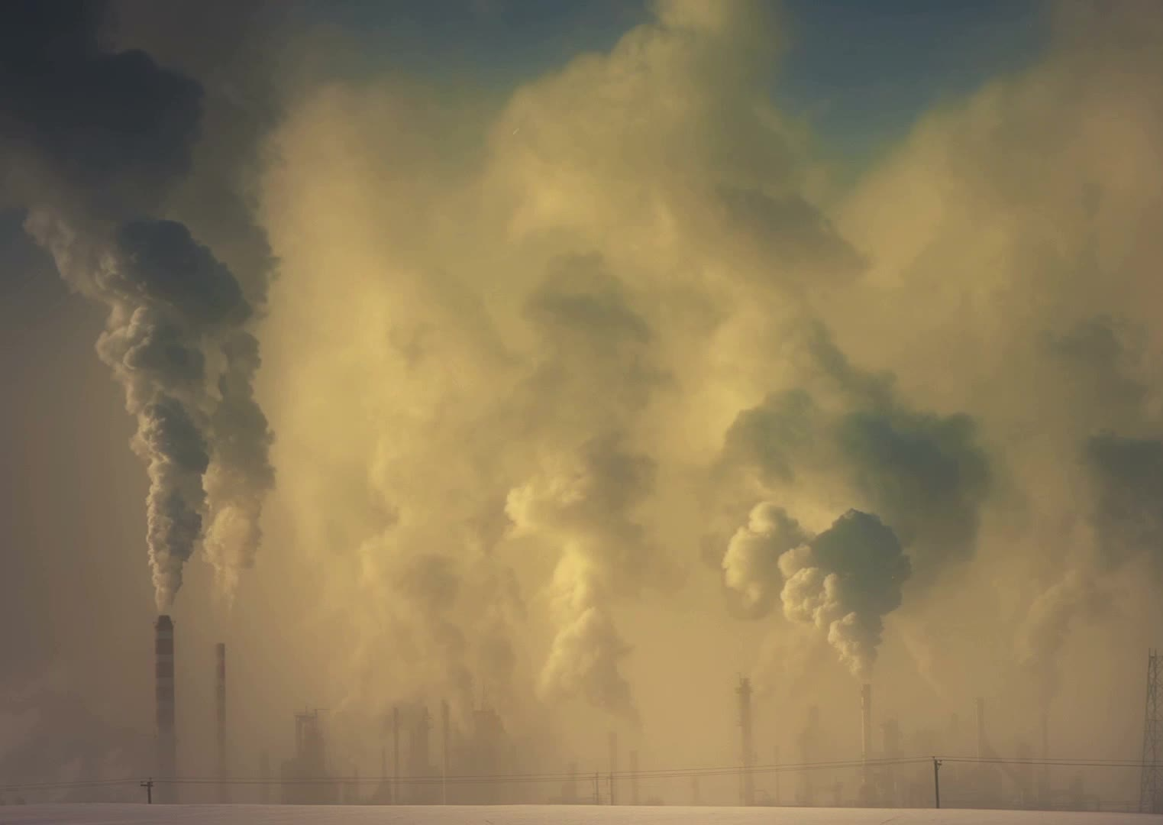
Research Outcomes: “Technology, Toxicity and Environmental Justice”
Perspectives on sustainability through Science and Technology Studies (STS) and Feminist Technoscience
Followed course design of SO471 → ”Technology, Toxicity and Environmental Justice”
Designed the lecture with two main readings + extended reading list
22-slide presentation + lecture ‘script’ + reading list

Slide 4
WEEK___: TECHNOLOGY, TOXICITY AND ENVIRONMENTAL JUSTICE
“This week’s lecture and readings build on the theories of understanding technologies as sociotechnical systems, previously discussed in the course, to further explore technology’s relationship with (un)sustainability. Drawing from STS, feminist technoscience, environmental justice, and indigenous scholarship, the lecture examines what it means to live and act in a “permanently polluted world” (Liboiron, Tironi, and Calvillo 2018).”

Slide 5
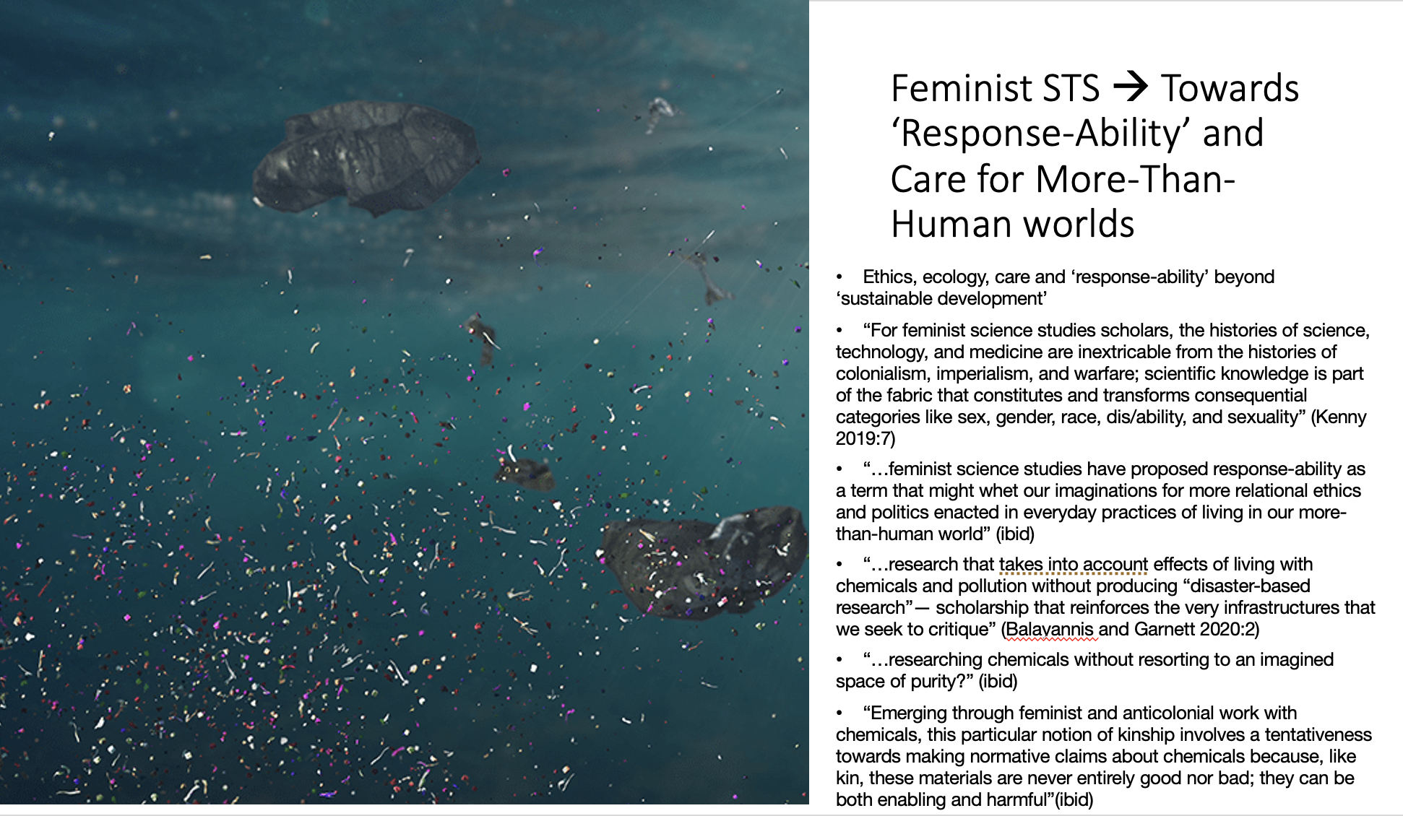
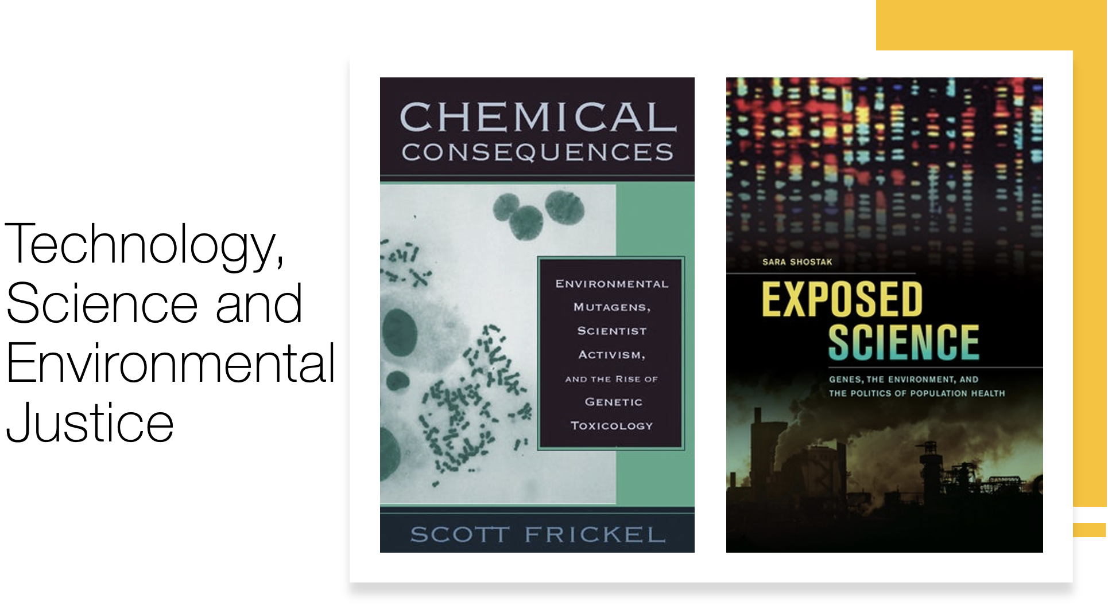
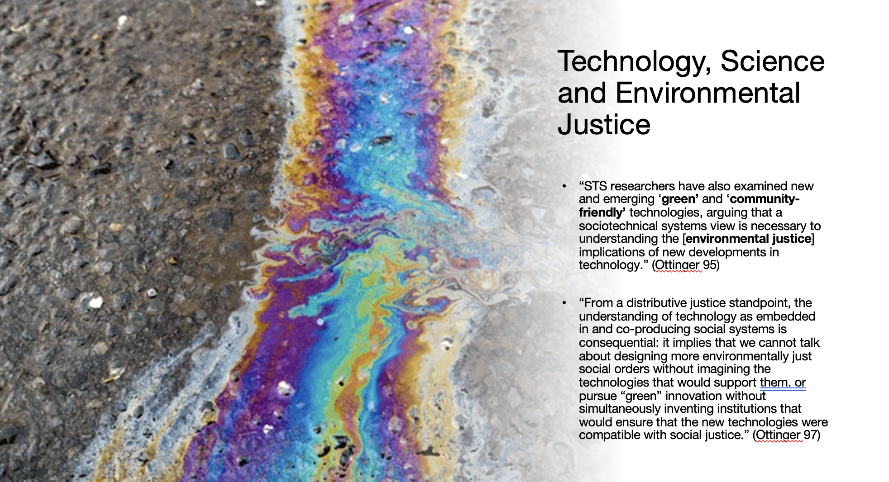
Snapshot of lecture slides:

Slide 6
Creating Reading List:

Slide 7
Internship Reflections
‘Mapping’ the Field:
Sustainability and Education:
Personal development:
Research project that inspired me both in my MSc dissertation and future research project
Suggestions:
Meet-up with other student interns
Skills in creating a comprehensive overview of a topic
potential educational exercise for students?
Working within the frame of the course to integrate questions of sustainability – sustainability not as separate to the field in question
Looking towards how the unique perspectives that comes with the course can give students tools to think about sustainability
Introductory toolkit for the student interns
Confidence in independent research process

