Slide 1

Inclusive Assessment, GenAI and Anticipatory Duty
Eden Centre

Slide 2
Content:
Part One: Equality Act, Anticipatory Duty and LSE Policy
Part Two: Designing Inclusive Assessment
Part Three: Observed Assessment, Inclusive Assessment and GenAI
Part Four: Links to Resources and Key Contacts

Slide 3
Part One: Equality Act, Anticipatory Duty, and LSE Reasonable Adjustment Policy

Slide 4
The Duty to make Reasonable Adjustments
The reasonable adjustments duty was first introduced under the Disability Discrimination Act 1995. The reasonable adjustments duty under the Equality Act operates slightly differently but the object is the same: to avoid as far as possible by reasonable means the disadvantage which a disabled student experiences because of their disability.
The duty requires us to take positive steps to ensure that disabled students can fully participate in the education and other benefits, facilities and services provided for students.

Slide 5
The Equality Act 2010
Anticipatory Duty is not new: The Equality Act 2010 and Anticipatory Duty
For service providers, the duty to make reasonable adjustments is 'anticipatory', within reason. This means they have to anticipate, think about and try to predict what adjustments could be needed by customers with different types of disability, support and access requirements.
The service provider must think about all potential disabled customers and not just those who are known to them.

Slide 6
Introduction to EHRC Briefing note:
Key principles from EHRC briefing, anticipatory duty and reasonable adjustments

Slide 7
Student-facing staff should be trained to recognise symptoms of mental health crises and trained to know what to do next to obtain support for the student and remove additional stressors such as deadlines.
Staff should be reminded that where a student has a severe or urgent condition, reasonable adjustments may be made without a diagnosis or medical or expert evidence.
Where a student does not have a diagnosis of disability, but staff are concerned that the student is struggling or failing to engage, staff should take steps to determine whether a student may have a disability and whether to put reasonable adjustments in place. Such steps may include consideration of what the student says about their disability or health condition and how they present when speaking to staff and peers. Their behaviour may also be taken into consideration, for example, attendance at lectures, submission of work, general engagement with courses and other activities and whether there are discrepancies between certain modules or formats of assessment.
Notes:
Information only

Slide 8
LSE Reasonable Adjustment Policy
LSE is committed to fostering an inclusive learning environment where disabled students have equality of access, experience, and outcomes with their non-disabled peers.
Our Reasonable Adjustments Policy sets out the School's approach to maintaining this environment and supporting disabled students, balancing carefully the demands of academic standards and the rights of our students under the Equality Act 2010, along with other relevant legislation.

Slide 9
LSE’s Reasonable Adjustments Policy ensures disabled students have equal access and experience under the Equality Act 2010.
Anticipatory Duty: We plan adjustments proactively, not just on request.
Definition: A disability is a substantial, long-term condition affecting daily activities.
Adjustments: May include changes to teaching/assessment, physical spaces, or assistive technology.
Process: The Disability & Mental Health Service (DMHS) works with students to create a confidential “My Adjustments” plan.
Staff Role: Apply adjustments, maintain academic standards, and refer students to DMHS when needed.

Slide 10
Links to support Reasonable Adjustment:
Staff Guide on Reasonable Adjustments: https://info.lse.ac.uk/current-students/student-wellbeing/disability-wellbeing/Information-for-Staff/Staff-Guidance-on-My-Adjustments
Reasonable Adjustment Policy: https://info.lse.ac.uk/current-students/student-wellbeing/disability-wellbeing/Information-for-Staff/Reasonable-Adjustments-Policy
Disability Referral Form: https://info.lse.ac.uk/current-students/student-wellbeing/disability-wellbeing/Disability-Referral-Form
Staff training on Reasonable Adjustment Policy: https://mystaffdevelopment.lse.ac.uk/learn/signin;redirectURL=%2Flearn%2Fcourses%2F281%2Fdisability-awareness-lse-reasonable-adjustments

Slide 11
Part Two: Designing Inclusive Assessment

Slide 12
Understanding the terminology of inclusive, alternative and modified assessment
Inclusive assessment focuses on the way in which assessment design can proactively minimise the likelihood of students being excluded, overlooked and/or disadvantaged through the ways in which they are assessed across their studies.
In the context of an assessment, a reasonable adjustment is a change to an assessment to ensure that a student has a fair and equitable opportunity to complete an assessment without disadvantage. Reasonable adjustments may include modified or alternative assessments.
An alternative assessment is where a student, for disability related reasons, is unable to engage in the same assessment as their peers, so an alternative assessment is needed. For example, where a student is unable to engage in a presentation, even with modifications, it may be appropriate to permit the student to complete a piece of written coursework instead.
A modified assessment is where a student undertakes the same assessment as their peers, but there is a modification to the assessment for disability related reasons. For example, additional time in an examination, or an individual room for a student to take an examination.

Slide 13
Examples of Alternative and Modified Assessments for Students Facing Assessment‑Related Barriers

Slide 14
Examples of Alternative and Modified Assessments (adapted from Salford University)
Barrier | Rationale for Approval | Examples of Assessment Modifications | Examples of Alternative Assessments
Recall | Where the ability to recall specific information is affected by a disability, particularly where time constraints increase stress and impair recall. Also applicable where medication impacts recall. | - Glossary of terms provided for the exam - Crib sheets allowed under agreed constraints - Open book exam | - Assessment strategy that does not rely on recall, e.g., assignment or presentation
Duration of Exam | Where the duration of the exam negatively impacts the student due to concentration/fatigue, excessive pain, or general health. Also, relevant when standard rest breaks (e.g., 10 minutes per hour) are insufficient, or when rest breaks and extra time extend the exam duration, worsening the impact that access arrangements aim to mitigate. | - Exam split into two shorter exams on the same day with extended rest break (under supervision) - Exam split into two shorter exams on different dates (requires second paper to ensure academic integrity) | - Assessment strategy with no time constraints, allowing rest breaks and a student-controlled environment, e.g., presentation or take-away exam paper
Exam Environment and Conditions | Where there are levels of stress which are outside of the normal expected levels which students sitting an exam may experience, which may be detrimental to the student’s health, which cannot be reduced to acceptable levels with the implementation of a separate room and/or rest breaks. | Paper completed away from exam venue as a takeaway paper | An assessment strategy which does not rely on an exam environment or which does not impose exam conditions for example an assignment, presentation, seen paper, online test or exam paper completed outside of exam room conditions.

Slide 15
Barrier | Rationale for Approval | Examples of Assessment Modifications | Examples of Alternative Assessments
Presentation delivered in front of an audience | The student experiences levels of anxiety/stress prior to or potentially during a presentation which are outside of the normal expected levels which students delivering a presentation may experience and which may therefore have a detrimental impact upon their health. | Permit student to submit a pre-recorded presentation. | An alternative assessment may only be considered where the actual delivery of a presentation is not a PSRB requirement/core competence /intended learning outcome.
Group work | Where individual characteristics make it extremely difficult (outside of the norm) when enforced to work with peers in a collaborative manner without increasing the level of anxiety to such an impact it may become detrimental to the student’s wellbeing. | After the initial negotiation of topics and assignments of tasks for the student to conduct their own individual aspect of research and to deliver their own section of the presentation without the requirements to collaborate with peers with regards content, timeframes and final presentation. | Alternative assessment may only be considered where group work and collaboration is not a PSRB requirement/core competence/ILO.
Timed Practical Assessment | Where individuals can demonstrate their competence but are unable to do so under time constraints. | - Additional time for demonstration of skills - Rest breaks between stations - Reading time prior to the assessment under quarantine conditions of brief/questions | - Student instructs a third party to demonstrate the skills (if not restricted by PSRB/core competencies/learning outcomes) - For example, giving instructions to a third party to carry out a procedure or task

Slide 16
LSE Assessment Toolkit: This toolkit offers structured guidance and practical tools to support inclusive, impactful assessment and feedback design across LSE: https://info.lse.ac.uk/staff/divisions/Eden-Centre/Assessment-and-Feedback-Toolkit/Inclusive-assessment
Assessment & Feedback Principles: Actionable principles that guide coherent, programme-level assessment design, balancing consistency with flexibility and addressing challenges like AI automation.
Programme and Course-Level Design: Guidance on mapping formative vs. summative assessments, ensuring clear links between learning outcomes and assessment choices.
Assessment Methods: A collection of diverse formats, from traditional essays and exams to portfolios, group work, presentations, and alternative formats to meet varied student needs.
Inclusive Assessment: Designed for all students, reducing need for individual adjustments by ensuring accessibility, authenticity, fairness, scaffolded support, and culturally sensitive content.
Marking and Moderation: Best practices for consistent and fair marking, including moderation workflows (not detailed but implied by structure).
Effective Feedback: Feedback as a dialogue, integrating written, audio, and peer formats to foster ongoing student learning conversations.
Technology Integration: Guidance on leveraging tools such as Moodle, Turnitin, Gradescope, Digi-exam for streamlined submission, marking, peer feedback, and enhanced digital literacies.
What’s Next? Encourages regular review and refinement of assessment strategies using data, student input, co-creation, workshops, and connecting with Eden Centre advisers, TQARO, and Disability and Mental Health Service.

Slide 17
Part Three: Observed Assessment, Inclusive Assessment and GenAI

Slide 18
Questions/Queries from Departments:
Exploring the use of in‑person, observed assessments as a response to generative AI, while raising concerns that such approaches may risk breaching anticipatory duty (The Abrahart judgment shows that requiring oral assessments without alternatives can breach the anticipatory duty if a student’s difficulties are apparent and adjustments were not explored).
How can assessment design proactively anticipate barriers for disabled students and embed inclusive practice from the outset?
Any new AI‑related assessment format such as in‑person oral assessment/observed assessment or tightly timed invigilated task and equality impact assessments – we need to ensure they do not inadvertently disadvantage particular groups.
How to design alternative assessments to in person exams.
Ethical AI: how to uphold academic integrity through assessment methods that remain inclusive and accessible.

Slide 19
LSE Guidance, for the academic year 2026/27 all programmes should ensure:
At the programme level, departments should use observed assessment methods to verify achievement of programme learning outcomes (PLOs).
This might include:
Use of appropriate observed assessment on one or more core courses to verify the achievement of PLOs and/or to provide a benchmark against which to judge student performance in other assessments.
Using observed assessment as a proportion of total assessment at either the course or programme level. Current sector practice varies from 25% to 60%.Note: Observed assessment encompasses different in-class assessments methods or assessments conducted using technologies that verify the authenticity of students' work, such as edit-tracking technologies.

Slide 20
Observed Assessment
Observed assessments such as live presentations can place students with anxiety, communication disabilities, or other conditions at substantial disadvantage. Under the Equality Act’s anticipatory duty, institutions should consider alternative formats wherever the spoken/live element is not a genuine competence standard.

Slide 21
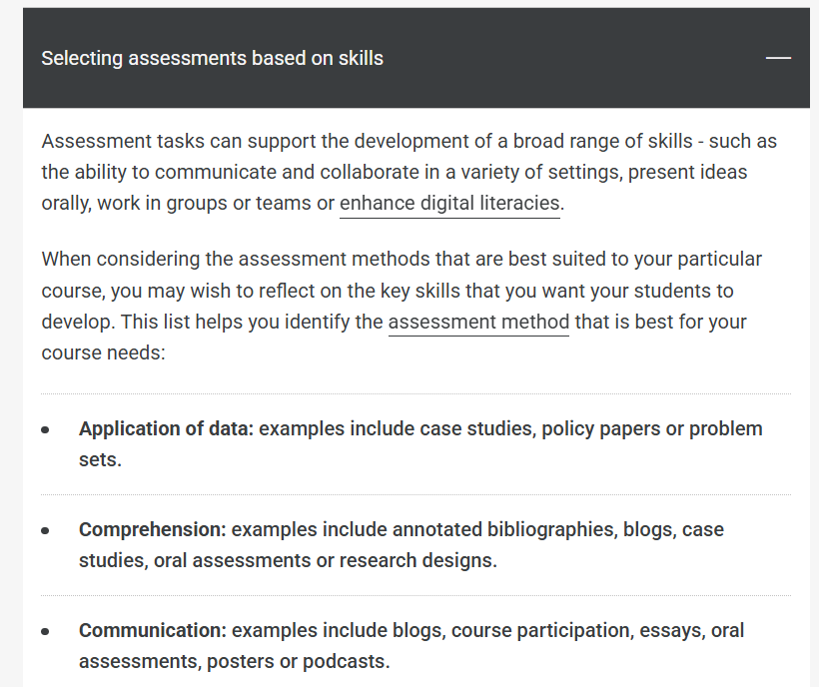
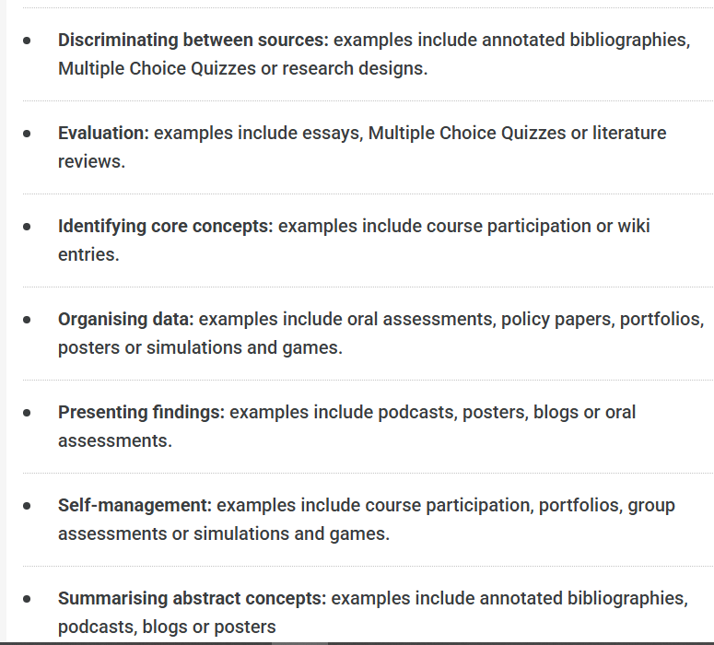
Selecting assessment tasks based on skills

Slide 22
Alternatives:
Recorded Presentations: Students submit narrated slides or video instead of presenting live. Supports flexibility and reduces performance anxiety.
Written Alternatives: Replace oral tasks with written reports or briefings where speaking isn't a competence standard.
Viva or 1-to-1 Presentations: Lower-pressure environment with a single assessor. Maintains oral element where essential.
Poster or Digital Artefact: Students create a poster, infographic, or visual and commentary to demonstrate learning.
Simulated/Recorded Practical Tasks: Students evidence performance through recordings, logs, or artefacts rather than live observation.

Slide 23
Why offer alternatives:
Offering alternatives enables students to demonstrate knowledge, skills, and competencies without unnecessary barriers. The goal is to ensure assessments measure what they intend --knowledge, reasoning, or analytical skill -- rather than comfort performing under observation. ​
Thoughtfully designed alternatives can preserve academic integrity while reducing stress and improving accessibility. Criteria for evaluating alternatives should include alignment with learning outcomes, transparent expectations, and equitable access to necessary resources. ​
Ultimately, rethinking observed assessments aligns with universal design for learning -- embedding accessibility and inclusivity from the start. This shift enhances engagement, improves inclusion, and supports compliance with anticipatory duty while maintaining academic standards.

Slide 24
Designing Assessment and GenAI: Designing assessment for inclusion and academic integrity.
Focus on content instead of structure and writing style when formulating questions.
Have students reflect on current events in the exam.
Focus your exam questions on recent articles or articles behind a paywall.
Embed reflection in assessment tasks, design tasks that assess the process as well as the product.

Slide 25
Newly developed and updated Eden resources
Anticipatory duty---- includes key points from the EHRC guidance, teaching scenarios, readings, guidance on assessment and learning outcomes.
Inclusive assessment ----- includes principles, practice and links to key processes and policies.
Assessment methods ----- includes guidance on academic integrity and inclusivity for each method.
Staff FAQs on GenAI and education ---- includes assessment design, communicating with your students, whether and how you might use GenAI in your teaching and marking and what to do if you suspect inappropriate use of GenAI.

Slide 26
Contacts
Departmental Advisers: https://info.lse.ac.uk/staff/divisions/Eden-Centre/Departmental-Advising
Alex Standen, Head of Academic Development: a.m.standen@lse.ac.uk
Akile Ahmet, Head of Inclusive Education: a.ahmet@lse.ac.uk

