Slide 1
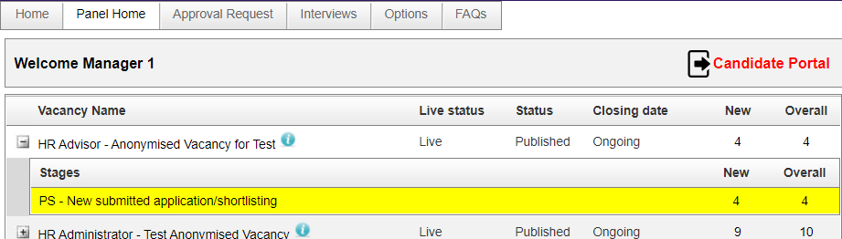
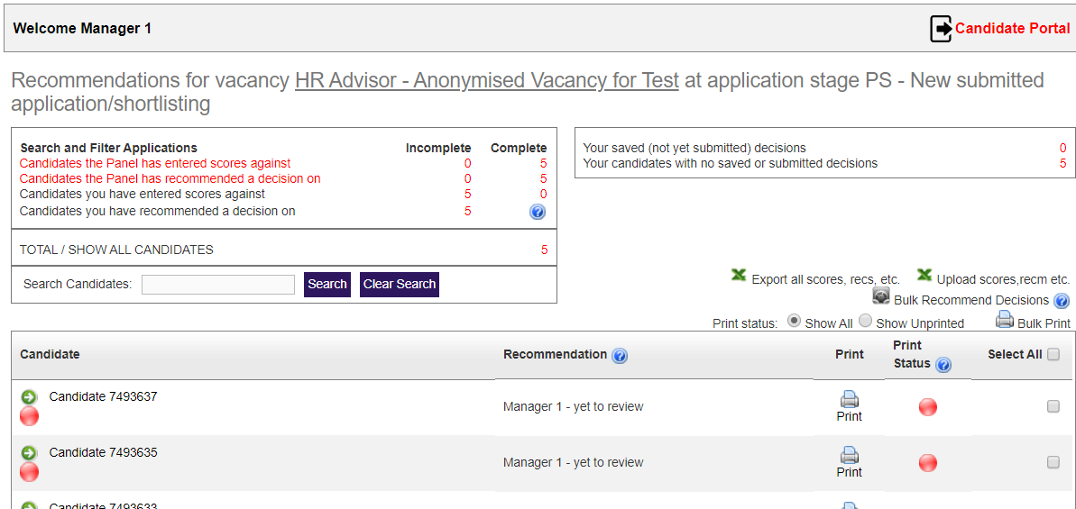
Shortlisting Professional Services vacancies – anonymised applications in the E-recruitment system
Viewing applications for a vacancy
You can view applications for a vacancy from the Panel Home tab. The Panel Home tab displays information about published vacancies including the vacancy name, status and the number of applications received for the vacancy.
Click the ‘+’ icon, on the vacancy you want to view, to expand the Stages tab. All vacancy stages that have one or more candidates are displayed. The status for vacancies which require shortlisting is PS – New submitted application/shortlisting.
Click the PS – New submitted application/shortlisting in the Stages tab. The Candidate recommendations page opens.
Viewing candidate recommendations
Applications are displayed on the Candidate recommendations page. Here, you can see the list of applications awaiting review. From the recommendations page you can review the applications. If required, you can also print and send copies to panel members.
Candidate: this is the candidate ID of the candidate.
Recommendation: this displays the review status of the application.
Note: for Professional Services vacancies, until an interview is confirmed, candidates are referred to by a candidate ID.

Slide 2
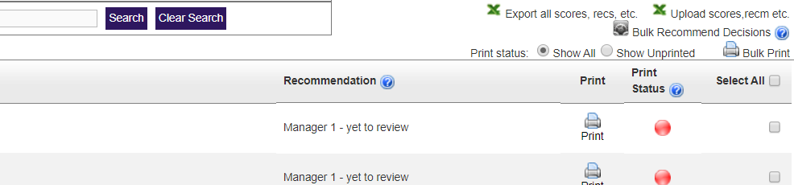
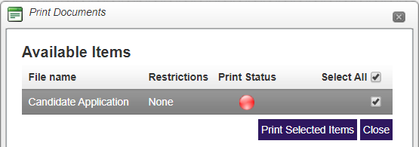
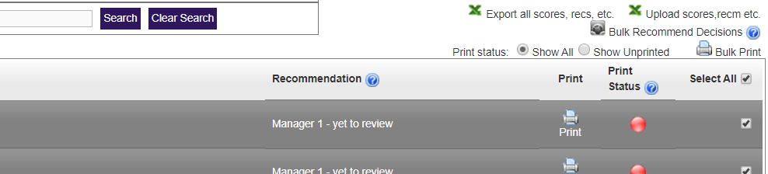
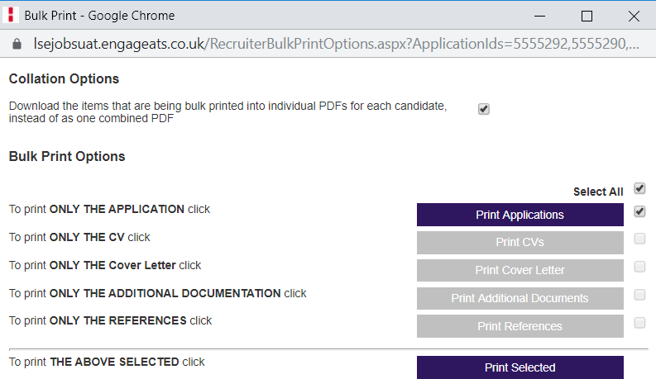
Shortlisting Professional Services vacancies – anonymised applications in the E-recruitment system
Printing application documents to pdf
You can print applications on an individual basis or use Bulk Print to print multiple applications. This is useful when completing a review of multiple applications via the shortlisting grid. See the next steps for more information.
To print an individual application to pdf:
Click Print on the candidate line in the grid. The Print Documents window opens.
Select the Candidate Application document.
Click Print Selected Items. The application is printed to pdf and downloaded as a zip file.
To print multiple applications at once:
Select the applications you want to print or select Select All. If there are multiple pages of applications you must scroll down and expand the page size to include all candidates on the first screen before clicking Select All.
Click Bulk Print. The Bulk Print window opens.
Select the checkbox to download as a single pdf or leave unselected to download each application as a separate pdf.
Select Print Applications to print applications.
Click Print Selected. The selected documents are printed to pdf and downloaded as a zip file.
If required you can share these with the panel members for review.

Slide 3
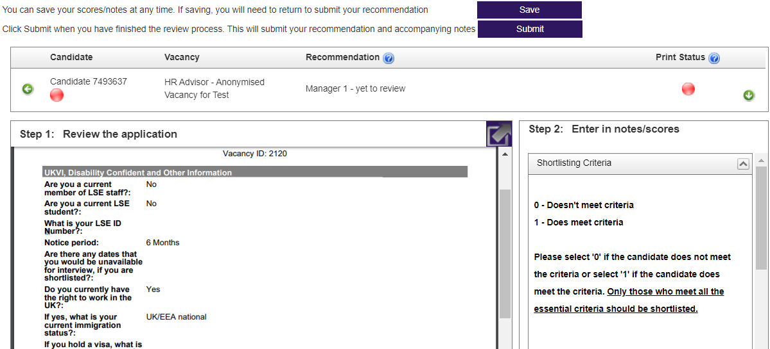
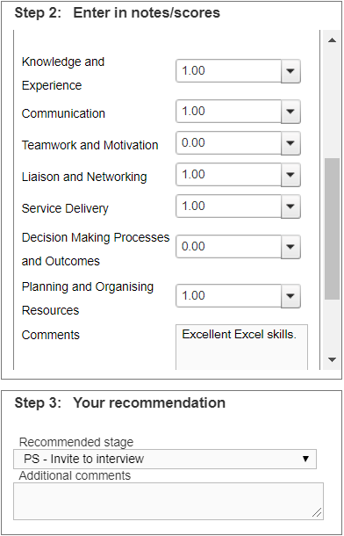
Shortlisting Professional Services vacancies – anonymised applications in the E-recruitment system
Reviewing candidate applications in the E-recruitment system
To open an application:
Click the candidate ID in the Candidate field. The Application page opens.
Candidate flags are on the candidate icon section in the picture above with the candidate ID. Candidate flags are displayed in the Candidate field. Hover the cursor over a candidate flag to see the status details, for example, if the candidate has applied under the Disability Confident scheme. There are two ways to shortlist your candidates.
Online, using the E-recruitment systems.
By exporting and importing final shortlisting decisions (explained on page 5)
Manually entering scores and recommendations
After you have reviewed the application you can enter scores and a recommendation for the candidate. You can enter the scores manually for each candidate on the E-recruitment system or export the data to Microsoft Excel before importing the updated scores to the E-recruitment system (explained in the Entering scores and recommendations via Excel shortlisting grid section on page 5 of this quick card).
To enter scores for the candidate you can use the pane titled Step 2: Enter in note/scores.
If the candidate meets the criteria, for example, Knowledge and Experience, Teamwork or Motivation, select 1 from the drop-down list.
If the candidate does not meet the criteria, select 0 from the drop-down list.
Comments: here you can enter any additional comments. For example, Excellent Excel skills.
Note: candidates are able to request access to, and view, their applications after scores, recommendations and any comments have been entered.

Slide 4
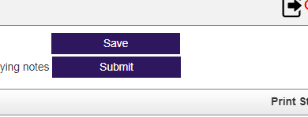
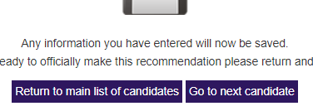
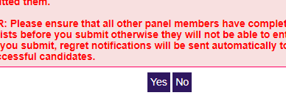
Shortlisting Professional Services vacancies – anonymised applications in the E-recruitment system
Manually entering scores and recommendations (continued)
After you have entered scores, you need to make your recommendation in regards to the application. You can select if you want to invite the candidate to interview or if you want to reject the application.
Step 3: to enter a recommendation for a candidate, use the Your recommendation pane:
Recommended stage: select the recommendation from the drop-down list. For example, PS - Invite to interview.
Additional comments: enter any additional comments.
Saving and submitting scores and recommendations
When you have entered the scores and recommendation for a candidate you can save the values entered. You can alternatively submit the scores and recommendations when all candidates have been reviewed or do this immediately.
To save the scores and recommendation for a candidate:
Click Save. The values are saved and the Save changes window opens.
To return to the candidate list, select Return to main list of candidates.
To go to the next candidate, select Go to next candidate.
To submit the scores and recommendation for a candidate:
Click Submit. A confirmation window opens.
If you want to submit the scores and recommendation, click Yes.
If you want to wait for other panel members to add their scores or recommendations, click No.
Important: scores or recommendations cannot be amended after they are submitted. The decisions that the Chair inputs into the system are final and actioned immediately. Therefore, the Chair should not submit the shortlisting decisions prior to discussion and agreement with the panel. Only the regret emails will be sent at this stage.

Slide 5
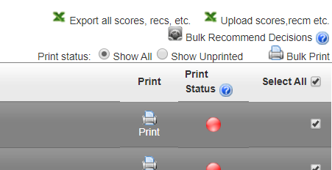
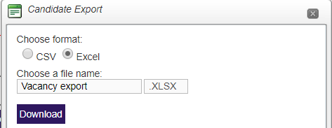

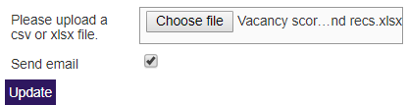
Shortlisting Professional Services vacancies – anonymised applications in the E-recruitment system
Entering scores and recommendations via Excel shortlisting grid
An alternative method of shortlisting is to download the shortlisting grid. You can export data to a Microsoft Excel file, update the scores and recommendations, and import the file into the E-recruitment system.
To export scores and recommendations to Excel from the Candidate recommendations page:
Click Select All. All candidates are selected in the grid. If there are multiple pages of applications you must scroll-down and expand the screen view to show all applications on the first page before selecting Select All to select all applications.
Click Export all scores, recs, etc.. The Candidate Export window is displayed.
Select the Excel checkbox.
Choose a file name: enter a name for the file, for example, Vacancy export.
Click Download. The file is downloaded.
You can now update the scores and recommendations in the Excel file.
Important: you must not apply any filters, add or remove columns or edit the format in Excel as this causes conflicts when uploading to the E-recruitment system.
When you have entered scores and recommendations in Excel, you must upload the file to the E-recruitment system.
To upload scores and recommendations to the E-recruitment system from Excel:
Click Upload scores, recm etc.. The Import manual scores and recommendations page opens.
Click Choose file and select the file you want to import.
If you have entered all scores and recommendations and want to submit recommendations to candidates via email, select Send email.
Click Update. Scores and recommendations are updated and emails are sent to rejected candidates. Emails to candidates invited for interview are sent when the interview schedules are created and published..
Click Panel Home, you can see that the vacancy status has now been updated.

