Slide 1
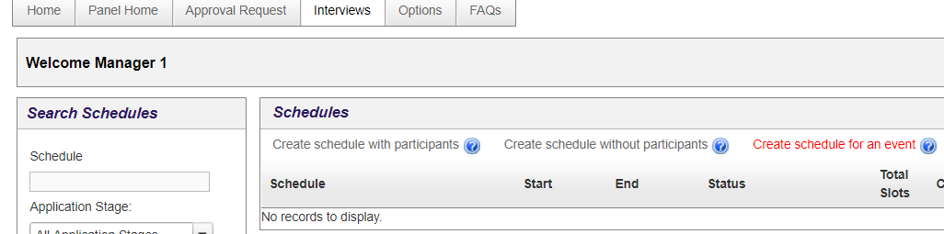

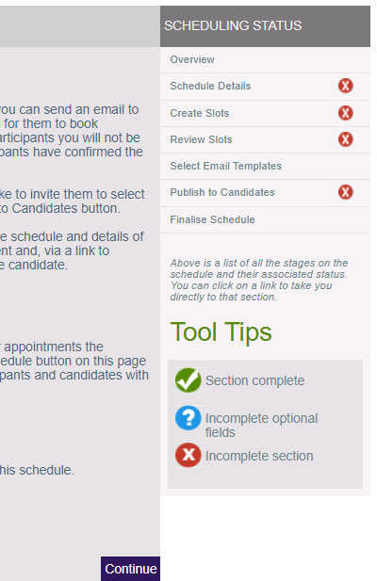
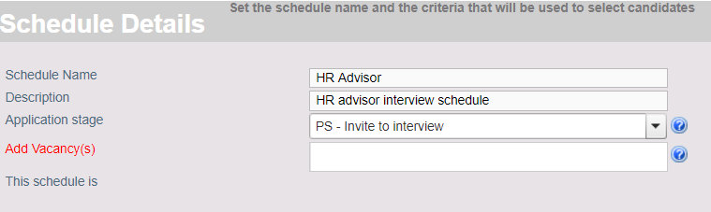
Scheduling interviews and assessments in the E-recruitment system
Step 1 → Creating an interview schedule
Once outcome decisions have been made at the shortlisting stage, you can then create an interview schedule. Candidates must be in the PS - Invite to Interview stage before they can be invited to an interview through the interview scheduler. Offline scheduling of Professional Services interviews by the candidate is not possible as the names and phone numbers of the candidates are not revealed until the interview is confirmed by them.
To create an interview schedule:
Click Interviews. The Interviews tab is displayed.
Click Create schedule without participants. The Overview page is displayed. The stages of the scheduling process are displayed in the SCHEDULING STATUS pane.
Note: when creating interview schedules for Professional Services vacancies, the candidates’ names are not visible in the E-recruitment system until interview slots have been confirmed by candidates.
To progress the scheduling status and begin entering the schedule details, click Continue.
Schedule Name: enter a name for the schedule. For example, HR Adviser.
Description: enter a description for the schedule. For example, HR Adviser interview schedule.
Application stage: select the application stage from the drop-down list. For example, PS – Invite to interview.
To select the vacancy for this interview schedule, click Add Vacancy. The Search Vacancies window opens.

Slide 2
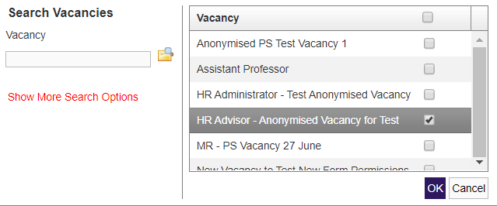

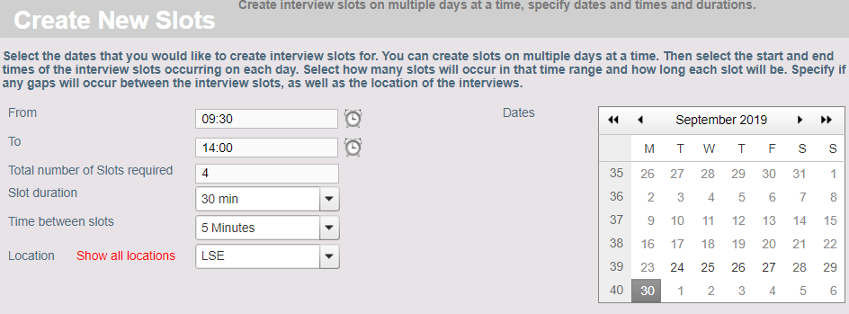
Scheduling interviews and assessments in the E-recruitment system
Step 1 → Creating an interview schedule (continued)
Current vacancies, assigned to the vacancy manager are displayed on the Vacancy pane.
Select the vacancy you want to create an interview schedule for and click OK. The Add Vacancy(s) field is automatically populated with the selected vacancy.
Note: you can search for and filter vacancies using the search field and Show More Search Options.
When you have entered the schedule details, click Save and Continue. The scheduling status is updated and the Create Slots page opens.
Step 2 → Creating slots
After you have entered and saved the schedule details you must create the interview slots. Multiple sets of interview slots can be created and interview slots may overlap. For example, if candidates must also complete an assessment.
To create new interview slots:
From: enter or select the start time of the first interview slot. For example, 09:30.
To: enter or select the end time of the last interview slot. For example, 17:00.
Total number of Slots required: enter the total number of slots you want to schedule. For example, 4.
Slot duration: enter the duration of each interview. For example, 30 minutes.
Time between slots: enter the time between each interview. For example, 5 minutes.
Location: click Show all locations and select LSE from the drop-down
Dates: select the date you want to schedule interviews for. For example, 30/09/2019.

Slide 3

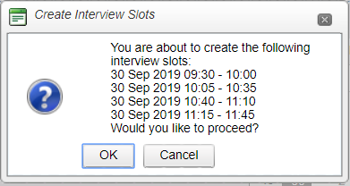

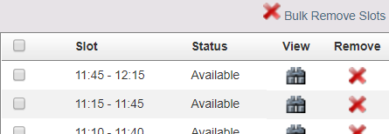
Scheduling interviews and assessments in the E-recruitment system
Step 2 → Creating slots (continued)
When you have entered the interview slot parameters, click Add Interview Slots. The interview slots are automatically scheduled according to the parameters you entered. The Create Interview Slots windows opens.
The interview slots are displayed in date and time order. If you want to proceed and create the slots, click OK. The slots are created and the scheduling status is updated.
Note: if candidates also need to complete an assessment, you can create multiple, overlapping interview slots. For example, if four candidates need to complete a 30-minute interview and a 30-minute assessment, you can create four individual one-hour slots overlapping by half an hour. For example, the first slot starting at 09:30, the second starting at 10:00. This can be done by adding the slots one by one instead of creating bulk slots.
When you have added all required interview slots, click Next. The Review Slots page opens.
Step 3 → Reviewing slots
You can review the slots you created for your interview schedule, view slot details, or remove slots individually or by using bulk remove.
To view details of a slot, click the binoculars icon on the slot line.
To remove a slot, click the cross icon on the slot line.
To remove multiple slots, select the slots and click Bulk Remove Slots.
When you have reviewed the slots, click Next. The Select Email Templates page opens.

Slide 4
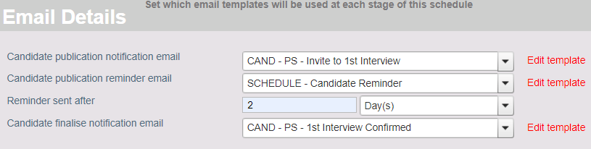
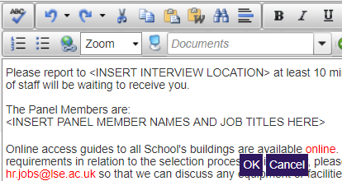

Scheduling interviews and assessments in the E-recruitment system
Step 5 → Selecting and editing email templates
When you have created the interview slots, you must select the email templates to be sent to candidates. You must amend the templates to include the information specific to the vacancy and interview schedule. For example, the interview location, panel members and details of any assessment or presentation required. You must also select templates for the publication notification, reminder, and interview finalising emails to be sent.
Candidate publication notification email: select the template from the drop-down list. For example, CAND - PS - Invite to 1st interview.
Candidate publication notification email: SCHEDULE – Candidate Reminder.
Reminder sent after: enter the time period after which a reminder email is sent to candidates who have not yet confirmed an interview slot. For example, 2 Day(s).
Candidate finalise notification email: select the template from the drop-down list. For example, CAND – PS - 1st Interview Confirmed.
When you have selected the email templates to be sent, you must edit the Candidate publication notification email:
Click Edit template. The Add Email Template window opens.
Sections which require editing are displayed in all capitals in brackets. For example, <INSERT INTERVIEW LOCATION>.
Edit all relevant sections of the template and click OK.
Note: Please note that for Professional Services roles you must select email templates beginning with CAND - PS
Note: information which is automatically populated from the vacancy details is displayed between {} brackets. For example, {VacancyTitle}.
When you have edited the Candidate publication notification email click Save and Continue. A warning message is displayed reminding you to edit the selected Candidate publication notification email. Click OK. The email templates are saved and the Publish to Candidates page opens.
Note: remember that for Professional Services, applications are anonymised. Therefore, for Professional Services vacancies, names and emails are not displayed on the Publish to Candidates page until candidates have confirmed an interview slot.

Slide 5
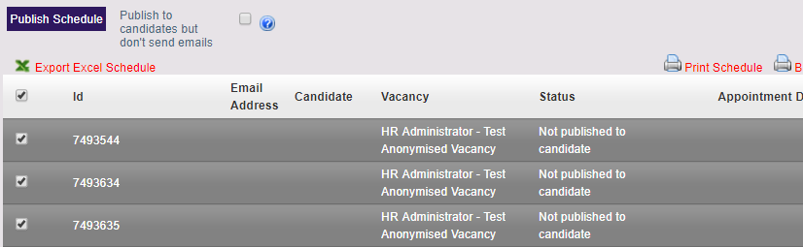
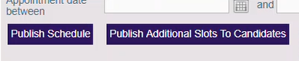
Scheduling interviews and assessments in the E-recruitment system
Step 6 → Publishing the schedule to candidates
After you have selected and edited the templates to be sent, you must publish the schedule to candidates. Once the interview schedule is published to candidates, candidates can confirm an interview slot. Additional slots can be published after this point, if required. You can, publish the schedule without sending emails to candidates then allocate slots yourself. (This is explained in the next section.)
To publish the schedule to candidates to self-select interview slots:
Select the candidates to be invited to interview by selecting the checkbox next to their IDs and then click Publish Schedule. A warning message is displayed, asking if you want to continue.
Click OK. The interview schedule is published to candidates and emails are sent. The scheduling status is updated to Published to Candidates.
If a candidate cannot attend any of the published interview slots, the vacancy manager can create additional slots and publish these.
To publish additional slots to candidates:
Click Publish Additional Slots to Candidates. A warning message is displayed, asking if you want to continue.
Click OK. The interview schedule is published to candidates and emails are sent. The scheduling status is updated to Published to Candidates.

Slide 6
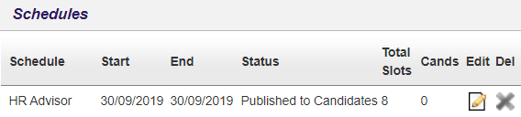
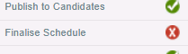
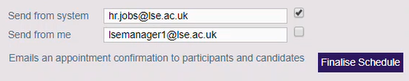



Scheduling interviews and assessments in the E-recruitment system
Step 8 → Finalising the schedule
When a candidate selects and confirms an interview slot, the date and time of the slot is displayed on the Publish to Candidates page. When all candidates have selected an interview slot, you must finalise the schedule.
From the Interviews tab:
Click Edit on the schedule displayed in the schedules pane. The schedule opens.
Click Publish to Candidates. The candidates and their selected slots are displayed.
To finalise the schedule:
Click Finalise Schedule. The Finalise Schedule page opens.
Click Finalise Schedule. The schedule is finalised and confirmation emails are sent to candidates. The scheduling status is updated to Schedule Finalised.
Note: the schedule can be finalised before all candidates have selected a slot. For example, if some candidates do not respond to emails before the deadline. However, it is recommended that the schedule is not finalised before every candidate has either accepted or rejected the interview invitation. Confirmation emails will only go to those who have confirmed their interview slots.
Step 9 → Printing the interview schedule and exporting to Excel
You can print the interview schedule or export the schedule data to Microsoft Excel.
To print the schedule from the Publish to Candidates page:
Click Print Schedule. A preview window opens.
Click the print icon to print the schedule.
To export the schedule to Excel:
Click Export Excel Schedule. The schedule data is downloaded in Excel format.

Slide 7
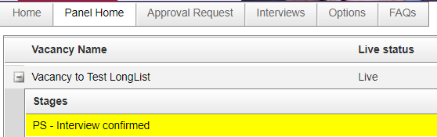
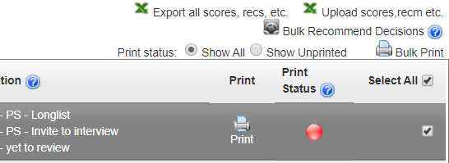
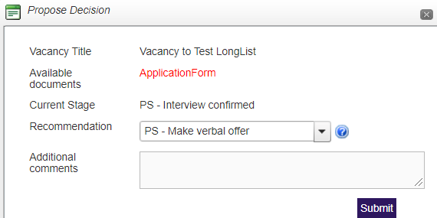
Scheduling interviews and assessments in the E-recruitment system
Step 10 → Making recommendations about candidates after interview
After interviews have been conducted, you must make recommendations for each candidate so that unsuccessful candidates can be informed, and the successful candidate can be progressed to the next stage.
To make recommendations after an interview:
From the Panel Home tab, select the vacancy.
Select a candidate or multiple candidates and click Bulk Recommend Decisions. The Propose Decision window opens.
Recommendation: select the recommendation from the drop-down list. For example, PS – Make verbal offer.
Click Submit. A warning message is displayed asking if you want to continue and send recommendation emails. Emails are only sent to unsuccessful candidates informing them that their application was unsuccessful.
Click Yes. Recommendation emails are sent to candidates.

