Slide 1
Wellbeing and Mental Health
Friday 23 APRIL 2021
Joanne Hay (Deputy COO)
HR Partnering, HR Policy, HR Organisational Learning
LSE Manager: Bringing Policy to Life
HR April 2021
Notes:
Disclaimer at start: the discussion today will involve discussions that may be sensitive and challenging; at the same time, it is important for you as managers to understand good practice approaches, tools and resources for managing wellbeing and mental health in your team(s).

Slide 2
Wellbeing and Mental Health
Overview…
Aims for this session
Introduction and context
School policy and supporting resources
Case studies
Best practice hints and tips
LSE Manager: Bringing Policy to Life HR April 2021

Slide 3
Wellbeing and Mental Health
Aims for this session…
Understand the School’s wellbeing and mental health resources for staff – what they cover, how they should be used and your role as a manager
Discuss good practice management approaches to mental health and wellbeing by working through scenarios in groups
Develop some best practice hints and tips
Understand how, as a manager, you can lead on promoting positive wellbeing and mental health
LSE Manager: Bringing Policy to Life HR April 2021

Slide 4

Wellbeing and Mental Health
Wellbeing is a journey…. It’s never too early or too late to work towards being the healthiest you.
Self care essentials:
Physical Health & Wellbeing
Nutrition & Hydration
Mental Health
Mindfulness
Resilience
Sleep hygiene

Slide 5
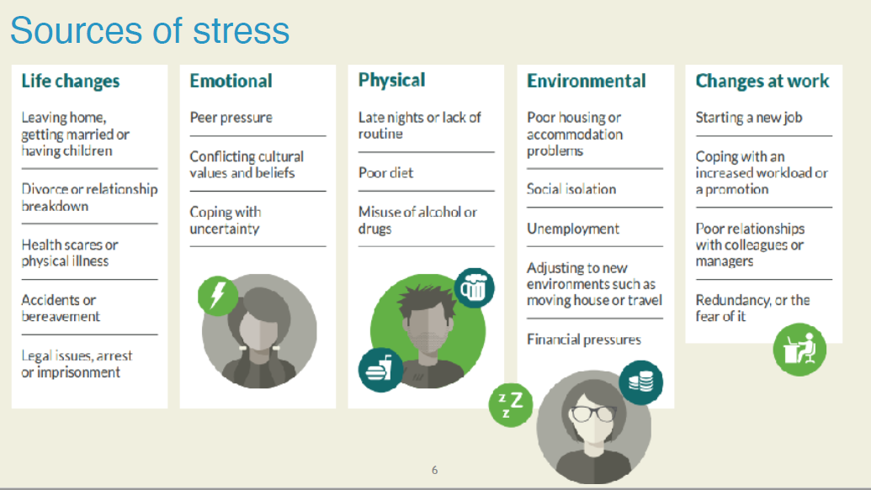
Wellbeing and Mental Health

Slide 6
Wellbeing and Mental Health
Introduction and context
Implications of COVID-19 and related lockdown for approaching wellbeing and mental health in the workplace:
      COVID-19 has directly impacted across the staff community (loss, stress, separation from friends & family)
      Ongoing working from home arrangements can present additional wellbeing & mental health challenges
      Greater focus on wellbeing & mental health in wider news, with changed expectations for employer’s role
Creating a workplace culture in which staff feel more comfortable raising wellbeing and mental health issues, and in which managers can identify and (where appropriate) address early signs that may be a cause for concern – this is supportive of LSE 2030, especially Priority 3 (‘Develop LSE for everyone’).
Wellbeing and mental health issues can be sensitive and difficult to discuss, but crucial to address as early as possible.
LSE Manager: Bringing Policy to Life HR April 2021

Slide 7
Wellbeing and Mental Health
Being proactive as a manager:
  Be aware that, if a wellbeing or mental health matter reaches a formal stage (e.g. a capability performance hearing where performance issues may be linked to wellbeing or mental health), you may be asked what support was in place for the individual.
  Spotting the early signs of a potential wellbeing or mental health issue: not participating, camera off, erratic behaviour, performance issues.
  Understand boundaries: when it would be appropriate to ask questions, when a matter may merit further investigation.
  Be aware of unconscious biases and avoid making assumptions about the reason(s) behind an individual’s behaviour or performance.
  Wellbeing and mental health support is not just for crises: regular, pre-emptive action is key to ongoing wellbeing in teams.
LSE Manager: Bringing Policy to Life HR April 2021

Slide 8
Wellbeing and Mental Health
Supporting resources
Employee Wellbeing Policy
Disability Policy
Reasonable adjustments
Staff Counselling services
Employee Assistance Programme (EAP): external resource for all staff (free and available 24/7)
Staff Wellbeing webpages
‘Wellbeing, What’s Out There?’ workshops
School’s Mental Health First Aid Network
Disability and Wellbeing Network (DAWN) and other Staff Networks
LSE Manager: Bringing Policy to Life HR April 2021
Notes:
Disability Policy is being substantially enhanced, also development of guidance and flowcharts on reasonable adjustments

Slide 9
Wellbeing and Mental Health
Additional resources for managers
Peer support
Training and development (HR Organisational Learning & others)
Occupational Health
Workstation assessments
Stress risk assessment
Individual risk assessment, including in support of return to campus
Contact your HR Partner!
LSE Manager: Bringing Policy to Life HR April 2021

Slide 10
Wellbeing and Mental Health
Case studies (in groups)
Case Study 1
Molly has been employed as a Placement Manager for 15 years at the LSE in the Department of Health Science. Molly’s role as Placement Manager involves line managing a team of 6 staff. Molly thoroughly enjoys her role and particularly prides herself on her meticulous approach to work and the valuable source of support she provides to her team. At the start of the first lockdown Molly was engaged and was able to quickly adapt to the new ways of working; however, since the second lockdown she has not been able to motivate her team in the way she was able to previously whilst working on campus. Due to home-schooling Molly was not able to carry out the monthly 1-1s with her team members and catching up with work outside of core hours proved problematic due to family commitments. Molly counted that she has 700 unread emails in her mailbox, which is particularly unusual for her as she actively responds to emails within 2 working days.
Molly has noticed that her team are not engaged in their work, which has led to her becoming increasingly frustrated at the poor standard of work being delivered. At the last team meeting a verbal altercation occurred between Molly and a team member where she was accused of “never [being] around.”
Molly has tried to catch up with her work by logging on at 6pm, however this often means that Molly is still working until 3am and she is struggling to wake up in the morning for work. Molly has also realised that she has missed a work deadline which could mean that 30 students will not be placed on the 2021/22 programme.
Are there any signs within this case study that would suggest that Molly is not doing well? As Molly’s line manager how would you address this?
LSE Manager: Bringing Policy to Life HR April 2021
Notes:
Note: All characters, Departments/Divisions and situations in these case studies are purely fictional, and any resemblance is coincidental

Slide 11
Wellbeing and Mental Health
Case Study 2
Following the return to campus preparations, you have met with your team to discuss the return to campus arrangements and agree on the timeline for the team to return.
During your meeting with the team Bryan, an Architectural Specialist, expressed his disappointment at having to return to campus. Bryan appeared agitated and angry at the meeting and had advised that he did not feel that the department had his best interests at heart by asking him to return to campus during the pandemic. You suggested that a separate meeting with Bryan may be helpful to discuss his concerns in more detail.
The following week you met with Bryan to discuss his concerns. Bryan explained that he had completed the Health Questionnaire however he was unlikely to need a risk assessment as he had no underlying health conditions. Bryan advised that he felt anxious and stressed at the thought of returning to campus and being amongst so many people. He explained that he had purposefully not rode on public transport for over 1 year and the thought of going on public transport also frightened him to the extent that he is having sleepless nights. Bryan advised that his wife had recently contracted COVID, which was a pretty traumatic experience for his family. He also went on to advise that he had lost a close friend due to COVID and he is petrified of contracting the virus. Bryan appeared visibly upset and had to pause throughout the conversation to compose himself.
Bryan expressed his anger at having to return to campus particularly as his role ‘is not as front-facing as other teams’ and felt that he should be allowed to continue working remotely indefinitely. Bryan informed you that he has no intention of returning to campus on the anticipated date as he feels you have done nothing to alleviate his fears as his line manager.
As Bryan’s line manager how would you address this issue?
LSE Manager: Bringing Policy to Life HR April 2021

Slide 12
Wellbeing and Mental Health
Case Study 3
Josie has been employed at LSE for five years as one of the Programme Managers in the Department of Philosophy. She has always been extremely motivated in her role, has really enjoyed developing good relationships with the students and her colleagues as well as keenly volunteering for School wide projects. In all the student satisfaction surveys the scores for the courses she manages always score highly for being professionally run.
At the beginning of the pandemic, all seemed well with Josie’s productivity and her continued engagement with the team, the Department and wider School. Not only did Josie rise up to the difficult challenge of carrying out her role and managing the expectations of stressed students remotely, she also participated actively in Department activities to help contribute to team morale. She arranged weekly coffee morning sessions and began a book club to encourage social activity. Josie was also an effective manager to her direct reports providing direction, advise and support.
However over the last few months you have noticed a steady decline in Josie’s engagement and you sense that she has withdrawn. Students are now submitting complaints that their queries and questions are not been answered or followed through by Josie. You have also noticed that in the weekly programme meetings Josie arrives late, turns her camera off and hardly participates in any of the discussions. The two Co-ordinators and one Administrator who Josie line manages are also now escalating work issues to you as Josie is not responding to their emails and have also revealed to you that their 1:1 meetings with Josie are nearly always cancelled by her. The book club Josie set up has now been disbanded and another colleague in the Department has taken it upon themselves to run the coffee mornings as they too had stopped. Josie has taken several days off sick.
As Josie’s line manager how would you approach this issue. What aspects of Josie’s wellbeing would you like to explore further and what interventions might you consider?
LSE Manager: Bringing Policy to Life HR April 2021

Slide 13
Wellbeing and Mental Health
Case Study 4
Carlos has worked at LSE for two years. He was initially employed as Communications Officer in the European History Department and was promoted to Communications Manager six months before the pandemic started following a small restructure within the team. Carlos line manages three members of staff and although he has some experience of managing staff at his previous organisation, he has not had any experience of managing staff at the LSE.
Carlos has monthly 1:1 meetings with his direct reports and ensures he spends some time asking about their wellbeing. Over the course of the pandemic, one of his reports, Andrew, mentioned several times that he is fed up and it seems his overall wellbeing is deteriorating as the months go by. Andrew declared to Carlos that living on his own while working remotely is really getting to him. He has not been able to see his parents since the beginning of the pandemic as they are shielding in Brazil. He also revealed that his partner suggested they take a break from each other which has added to Andrew’s increasing depression.
Andrew informed Carlos that he had no-one else to talk to apart from Carlos and sends Carlos regular WhatsApp messages during the evenings and at weekends. At a recent meeting Andrew asks Carlos to promise him not to tell anyone else what he is about to say and then proceeds to tell Carlos that he had started to he have dark thoughts and suggested he didn’t like living anymore. As Carlos wanted to demonstrate that he was approachable and a trustworthy manager, Carlos reassures Andrew that he will keep this revelation to himself, although he makes Andrew promise that he should remain in constant contact with him. Carlos tells Andrew to try and be positive as things are getting better with the vaccine rollout and restrictions lifting soon.
If you were Carlos, is this the approach you would take? Is there anything you would do differently and if so what would you do and why?
LSE Manager: Bringing Policy to Life HR April 2021

Slide 14
Wellbeing and Mental Health
Case Study 5
Deirdre works in the Foreign Languages Department as a Study Co-Ordinator and has been employed at LSE for four years. Deirdre is the team leader of four other Co-ordinators.
Deirdre has always been a very productive member of the team but about six months ago, Deirdre started underperforming in her role. She started missing important deadlines and failed to attend strategic meetings that she was scheduled to feedback at and did not give any reasonable excuse as to why this kept occurring.
Deirdre’s manager, Patricia, started getting complaints from colleagues across the School. Patricia also noted that Deirdre started to be unable to follow simple instructions and directions in very basic tasks and was rude to her on several occasions when questioned her about this. In addition, Patricia noted that Deirdre had also become unable to give proper advise and direction to the members of staff that she supervises who were becoming fed up and demotivated themselves. Deirdre’s short term sickness absence has also increased recently.
Patricia spoke to Deirdre a number of times about her concerns and put a performance development plan in place which was effective for six weeks. This was in line with the informal stage of LSE’s Capability Performance Policy and Procedure for Professional Services Staff. After the six weeks, Patricia noted that there were some improvements but overall they were not sustained so Patricia moved to the formal stage of the procedure.
Do you agree with how Patricia is managing this issue and if so, why? Is there anything you would do differently and if so, what would that be?
LSE Manager: Bringing Policy to Life HR April 2021

Slide 15
Wellbeing and Mental Health
Best practice hints and tips
In groups…
What are the key lessons you have had from approaching wellbeing and mental health in your team(s) and from managing cases where wellbeing and/or mental health has been a significant factor?
What key hints and tips would you share with other managers?
LSE Manager: Bringing Policy to Life HR April 2021
Notes:
Include – write down details of conversations, as a record and also potentially to share confidentially, e.g. with HR Partner.

Slide 16
Wellbeing and Mental Health
Some final thoughts…
LSE Manager: Bringing Policy to Life HR April 2021

