Slide 1




Demystifying ADHD: Definitions, Barriers, and Diagnostic Journey

Slide 2




Before we start…
You are welcome to sit, stand, stretch and move around
Questions are welcome throughout the session
We are all learning, there are no bad questions
This is a safe, open and inclusive learning space for everyone

Slide 3

Let’s
introduce ourselves!
Nikita Montlake
(She / Her)
Inclusion Consultant

Slide 4
Our Agenda
Introductions and Housekeeping
Understanding ADHD and Dismantling Stereotypes
Diagnosis Process
Impacts Associated with ADHD
Celebrating the Strengths
Questions and Wrap Up

Slide 5


Slido Joining Instructions
Join at slido.com #LSE2
ⓘ
Click Present with Slido or install our Chrome extension to display joining instructions for participants while presenting.

Slide 6

Interactive Slido Question
What are you hoping to learn more about today?
ⓘ
Click Present with Slido or install our Chrome extension to activate this poll while presenting.

Slide 7

Understanding ADHD

Slide 8

What is ADHD?
Dysgraphia
Dyspraxia
Tic
Disorder
Autism
Attention Deficit Hyperactivity Disorder
Sensory Processing Disorder
Dyslexia
Tourette’s
Dyscalculia

Slide 9

What is ADHD?
ADHD is a neurodevelopmental difference. (Neurodiversity)
A constant part of someone's neurobiological set up.
Affects areas of the brain associated with attention, hyperactivity and impulsivity
8% of people in the UK are thought to have ADHD

Slide 10


Subtypes of ADHD
Impulsive/hyperactive type
Inattentive and distractible type
Combined type

Slide 11

Masking
A way of hiding symptoms through learned behaviors that can be healthy or unhealthy
Shame associated with masking
Masking can be emotionally taxing and affect mental health and social battery

Slide 12

Stereotypes and Stigma
Stereotypes and stigma prevent us understanding individual experiences
Create challenges accessing support

Slide 13
Myth vs Fact
Myth
Fact
ADHD only affects children. Adults ‘grow out of it’.
ADHD is a neurodevelopmental difference. It falls under the Neurodiversity umbrella.
Typified as a 'boys' behavioural disorder and associated with people from a low socio-economic background.
Causes are complex and multi-dimensional including biological, psychological and social factors.
People with ADHD are lazy and unmotivated.
8% of people in the UK are thought to have ADHD.

Slide 14

Effects of stereotypes and stigma
Social isolation
Deficit based culture
Workplace challenges
Challenges self advocating
Low self esteem
Mental Health
Access to support

Slide 15
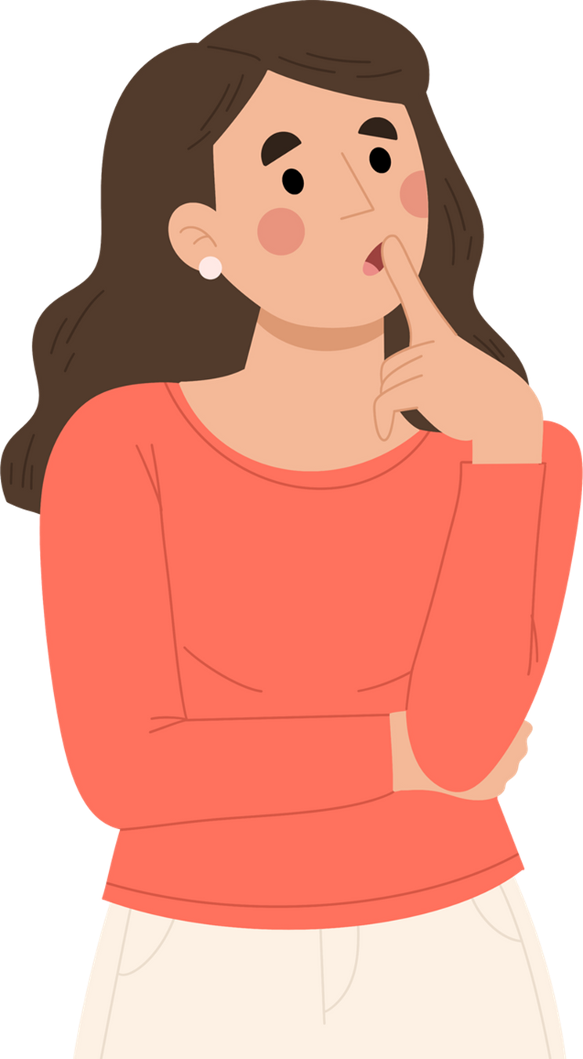
Accessing a Diagnosis

Slide 16

Diagnosis Process
Picked up by parent/teacher
Doctor visit
Potential referral to diagnostic centre
Gate-keeper barrier to diagnosis
Assessment wait time: varies across the country but very long
Gendered differences
Wait to get report back, official diagnosis
Alternate routes:
Psychiatry UK - Right to Choose
! Misdiagnosis !

Slide 17

Barriers to accessing a diagnosis:
Socio-Economics
Not noticing the signs
Shame, Denial and Learning Isolation
Communication barriers
Culture
Burden of disclosure
Understanding
No support before diagnosis

Slide 18
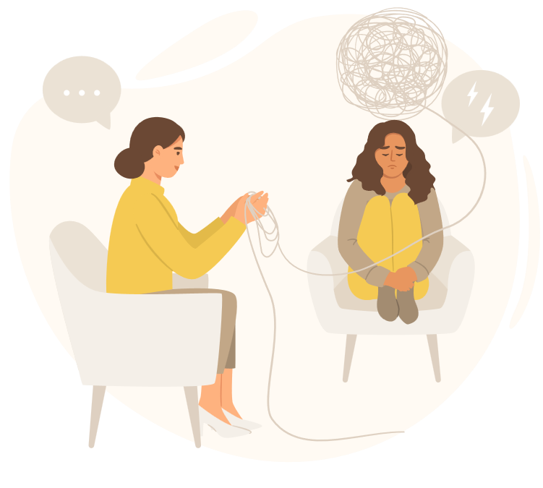
Recognising the barriers and celebrating the strengths

Slide 19
Impacts associated with ADHD
The Perception of Time
Executive Functioning
Sensory Processing
Sleep
Co-occurring
Conditions
Motivation
Rejection Sensitive Dysphoria (RSD)
Overwhelm / Anxiety

Slide 20


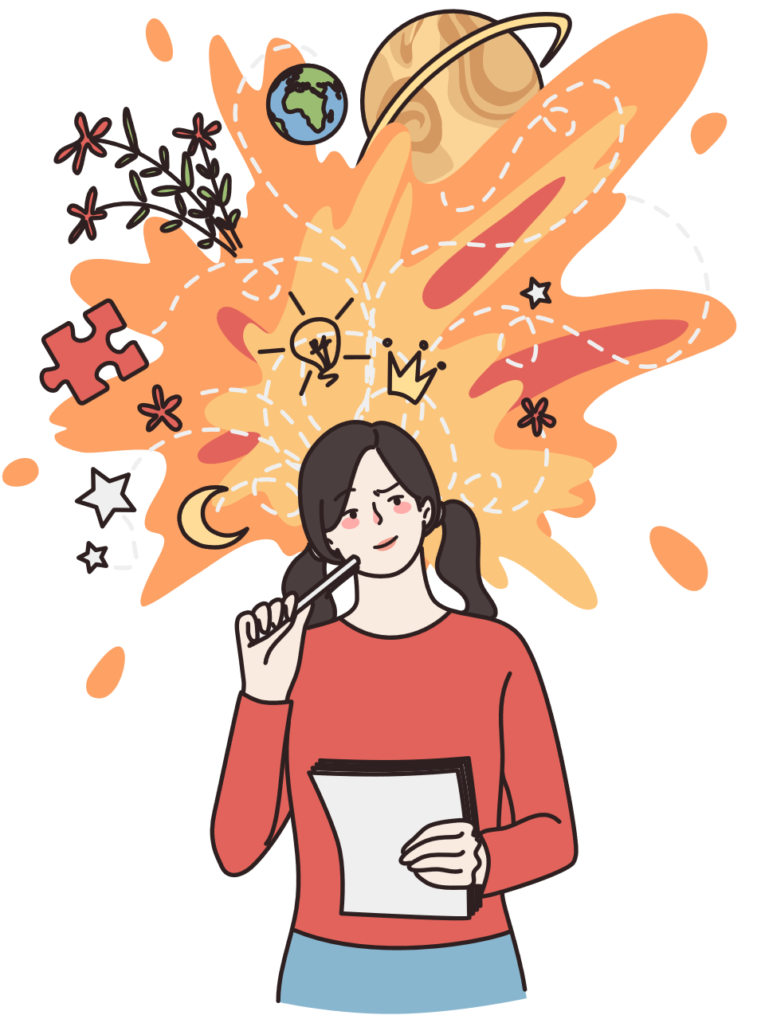
Celebrating the strengths
Creativity and innovation
Problem
Solving
Empathy and sensitivity

Slide 21



Celebrating the strengths
Hyperfocus
Diverse
perspectives
Speed and adaptability

Slide 22



Celebrating the strengths
Build strong relationships
Passionate and enthusiastic
Big picture
thinking

Slide 23


What can we do?
Improve our understanding of ADHD
Support the individual's experience
Celebrate strengths
Support with managing executive function barriers
Tackle anxieties
Apps/Tools/Assistive Technology

Slide 24

Next Webinar!
Don’t miss the next webinar!
Inclusion in the Workplace:
What Do Reasonable Adjustments for Neurodiverse Staff Look Like?
Wednesday 22nd May 2-3pm

Slide 25

Slido Interactive Question
Please share one word that sums up how you feel after today's session
ⓘ
Click Present with Slido or install our Chrome extension to activate this poll while presenting.

Slide 26

Slido Interactive Question
On a scale of 1-5, how much did you enjoy today's session? (1 is low, 5 is high)
ⓘ
Click Present with Slido or install our Chrome extension to activate this poll while presenting.

Slide 27

Any questions?

Slide 28





Keep in touch with us
Social Media:
Contact:
diversity-and-ability
ti@diversityandability.com
@dnamatters
diversityandability.com
@DandA_inclusion
@diversity_and_ability

